Slide 1
HARP Status Mapping
January 2016

Slide 2
Introduction
1
Import to have HARPed loans identified
Loans that have been refinanced through Home Affordable Refinance Program (HARP) generally prepay slower than other refinance loans that have undergone full underwriting.
Having HARPed loans accurately identified is important for the prepayment estimation.
2
Existing HARP mapping algorithm
Prior August 2013:
Before the period that Freddie Mac provided loan-level credit information for fully underwritten mortgages
Using MI matches to identify potential HARPed loans with OLTV > 80 and loan purpose as Refi-NCO
This algorithm cannot effectively identify HARPed loans with OLTV of 80% or lower
After August 2013
With the Freddie Mac and Fannie Mae credit information, the new algorithm can identify 30-year fixed –rate HARPed loans by mapping credit dataset with standard database
There is no restrictions on LTV ratio
The credit data set has about one year lag, which make is harder to mapping the recent originated loans

Slide 3
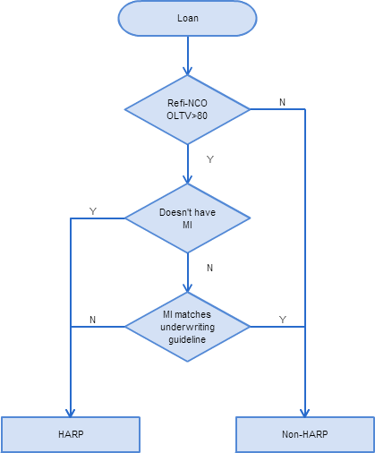
Existing Algorithm I MI Matching Method
Three Steps Mapping
Step 1: The loan should be refi-NCO loan, with Origination LTV >80.
Otherwise, it’s Non-HARP.
Step 2: If the loan doesn’t have MI, we match it as HARP loan;
If not, go to step 3.
Step 3: For the loan potentially has carry over MI. Check whether MI match current underwriting guideline. If doesn’t match, then it’s a HARPed loan.
Cons
Cannot match loans with OLTV equal or lower than 80.
Highly sensitive to the correctness of MI underwriting guideline.

Slide 4
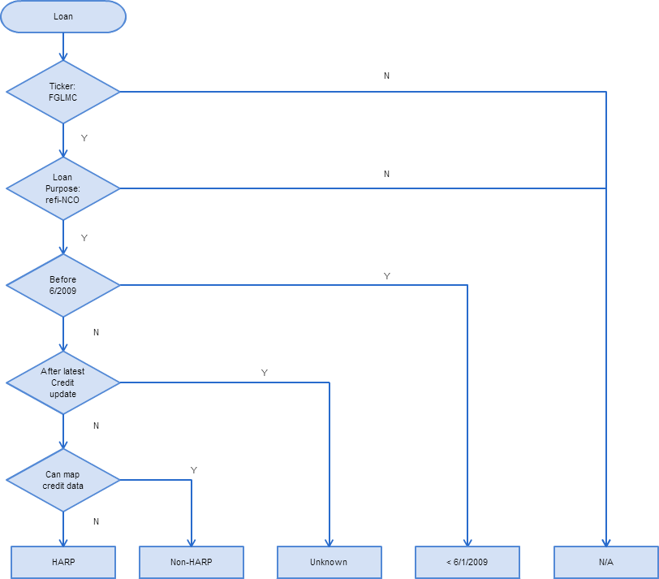
Existing Algorithm II Credit Dataset Mapping Method
Credit Data Mapping
No restriction on OLTV > 80.
More accurate as there is no dependency on MI underwriting criteria.
Cons
The credit data set has about one year lag, meaning we don’t have the most recent one year credit data. Then we have to mark the HARPed status as unknown for recent one year originated loans.

Slide 5
Existing Algorithm II Credit Dataset Mapping Method
Pre-HARP
HARP
Non-HARP
N/A: Purchas, refi-CO
All the blue area can be consider as non-HARPed loans; brown area is HARPed loans percentage.
Red area is the loans originated within the most recent year. The credit dataset has a gap on this area.
Need to improve the mapping for the red area.

Slide 6
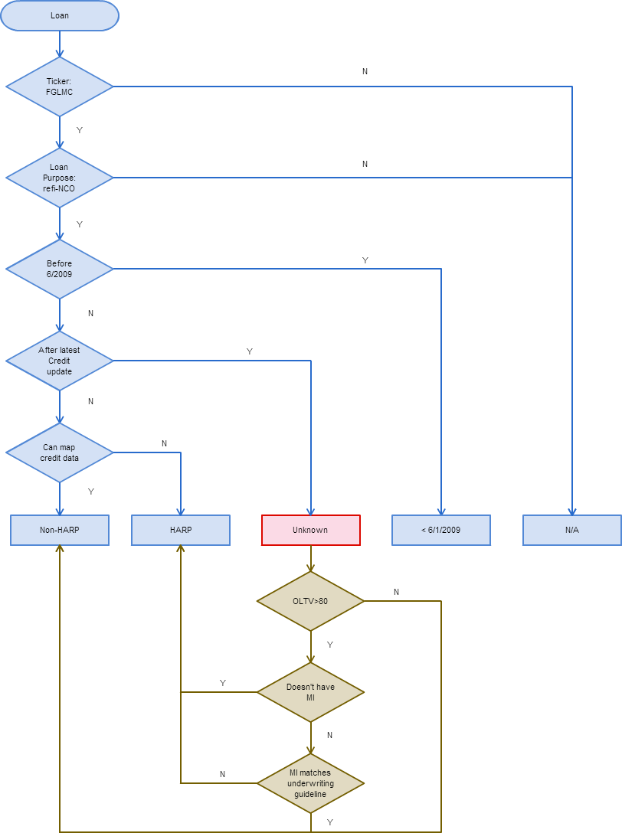
Enhanced Algorithm
Asof
Algorithm I
2009.01
...
2014.01
2016.01
120
Mapped Data | Un-mapped Data
Mapped Data | Un-mapped Data
OLTV
One-year gap, unable to map recent year HARP loans.
80
...
30
Asof
Algorithm II
2009.01
...
2014.01
2016.01
120
Mapped Data | Mapped Data
Un-mapped Data | Un-mapped Data
OLTV
80
...
Unable to map HARP loans with LTV <= 80.
30
Asof
Enhanced Algo.
2009.01
...
2014.01
2016.01
120
Mapped Data | Mapped Data
Mapped Data | Un-mapped Data
Integrate algo II into algo I for the unknown one year gap.
OLTV
80
...
30

